Slide 1

Machine Learning Project
Harish kunaparaju

Slide 2
Objective
The data set (fuel cost) consists of 608565 obs. of 23 variables.
Objective method used- K mean clustering.
What information is revealed by clustering?
How should the value for the number of clusters be chosen?
Select the best segmentation and describe the clusters. How would your segmentation help understand power generation in the US?

Slide 3
Objective method
The object method used for the dataset is K mean clustering as the dataset is large K means is usually used and relatively simple to use.
Method used: Silhouette
This method is used for separation distance from each cluster.
This measure has a range of (-1,1)
Silhouette coefficient – near to
+1 indicates that the sample is far from neighboring cluster.
0 indicates sample is on very close to decision boundary, and -1 indicates sample is assigned to wrong cluster.

Slide 4
Information after clustering
Removing all categorical variable and using K means silhouette method the optimal no of clusters are k=5 where the data point is near to +1.
Using fviz_cluster the cluster plot have 5clusters in total and the clusters lie between (0,1)
cluster 3,4 are below 0 which are near to the decision boundary
Other clusters 1,2,5 are away from the neighboring clusters.

Slide 5
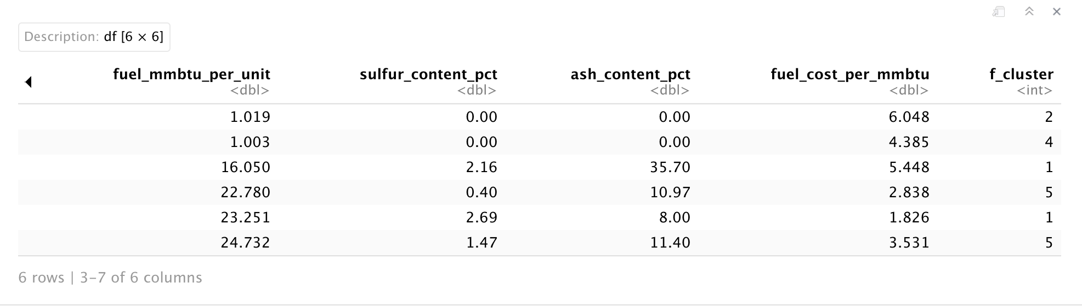
Heat generating in cluster 1 and 5 is more and cluster 2 and 4 is less per unit
And the sulfur content per unit in cluster 2 and 4 is 0.
And the sulfur content per unit in cluster 1 and 5 in more.

Slide 6
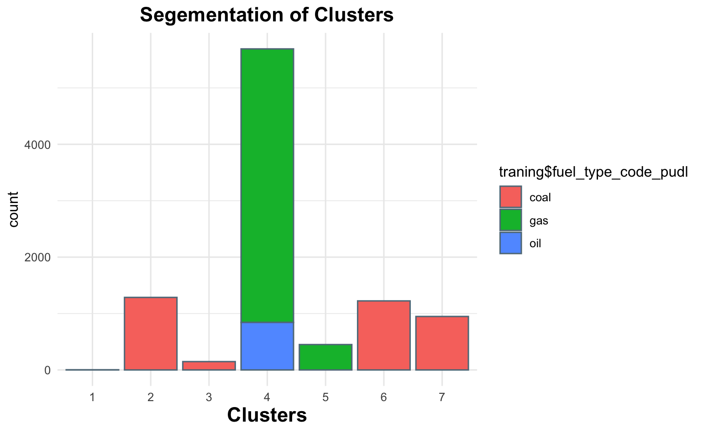
Segmentation
Fuel types- there are 3 types of fuel and gas being used more followed by coal and oil

Slide 7
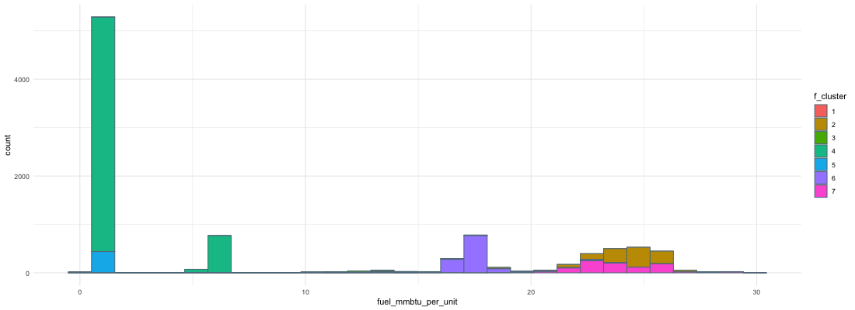
Fuel heat per unit
Cluster-4 have more heat per unit compared to other all clusters
Cluster-3 have less heat per unit

Slide 8
Conclusion
K means silhouette method the optimal no of clusters are k=5
In cluster plot only cluster 4 is near to 0 which is near to decision boundary.
Heat generating in cluster 1 and 5 is more and cluster 2 and 4 is less per unit
Sulfur content is more in cluster 1 and 5 and less 2 and 4

